Slide 1
ADK Laurentian Chapter
2023 Photo Contest Winners

Slide 2
Contest Judges
  Jean Giblin
  Jeanna Matthews
  Tom Ortmeyer
Organizer
  Tom Ortmeyer

Slide 3
Landscape Honorable Mention
Lows Ridge Downstream
Holly Woodworth

Slide 4
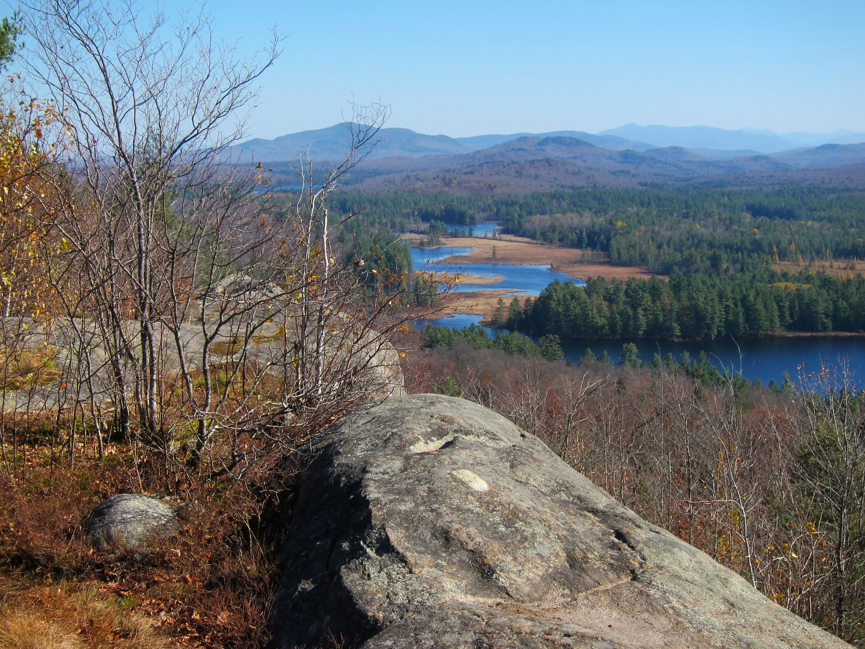

Slide 5
Landscape Honorable Mention
Debar Mountain from Deer River Flow
Greg Smith

Slide 6
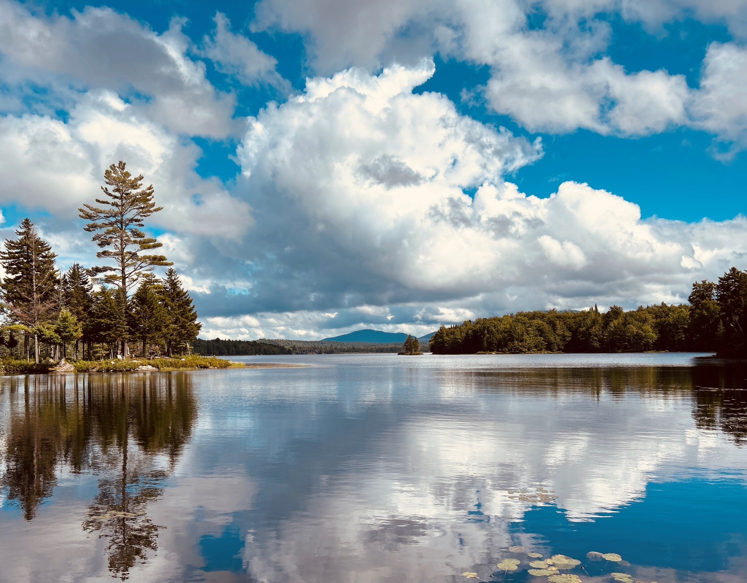

Slide 7
Landscape Honorable Mention
Azure
Angela Brown

Slide 8
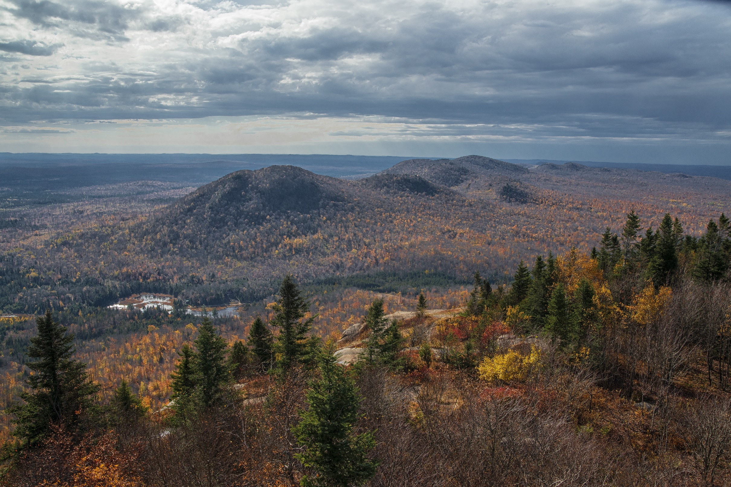

Slide 9
First Prize, Landscape
Autumn Dock at Dug Mountain
Bob Platte

Slide 10
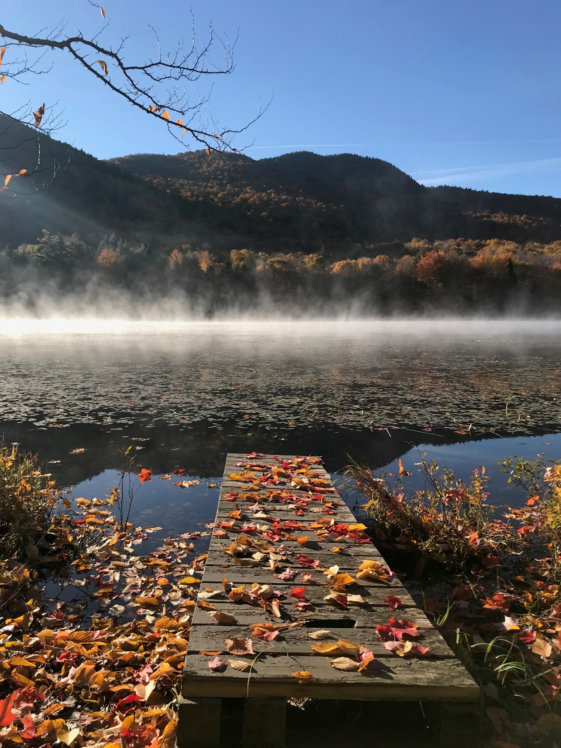

Slide 11
People Honorable Mention
West Parishville Snowshoe
Rose Rivezzi

Slide 12
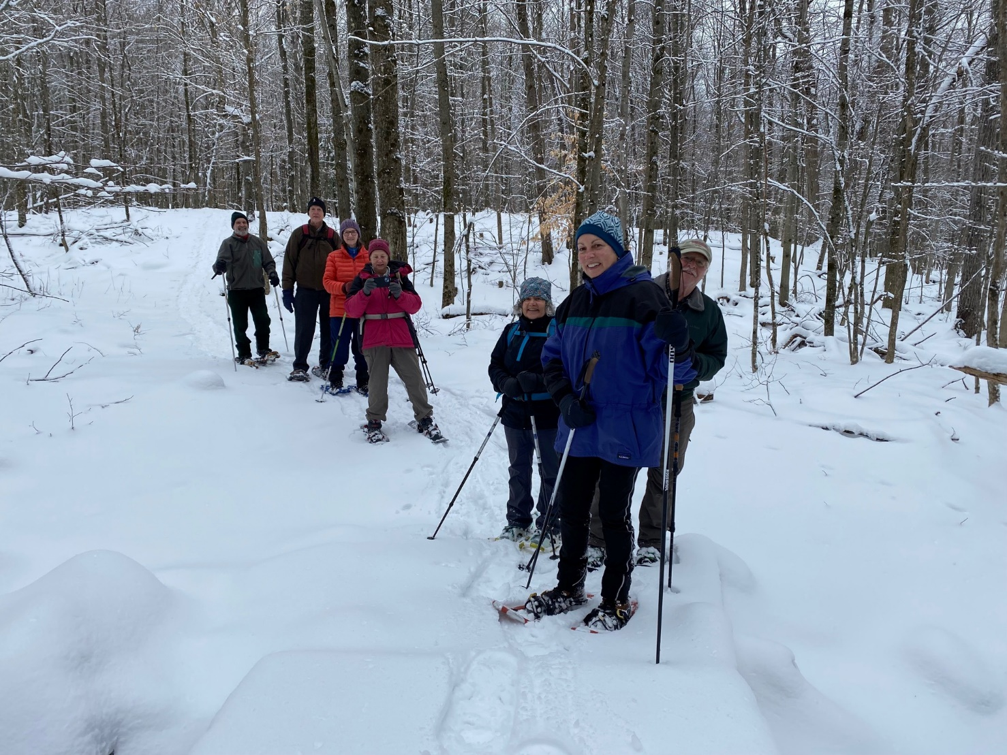

Slide 13
People Honorable Mention
Higley Erratic Boulder
Marianne Hebert

Slide 14
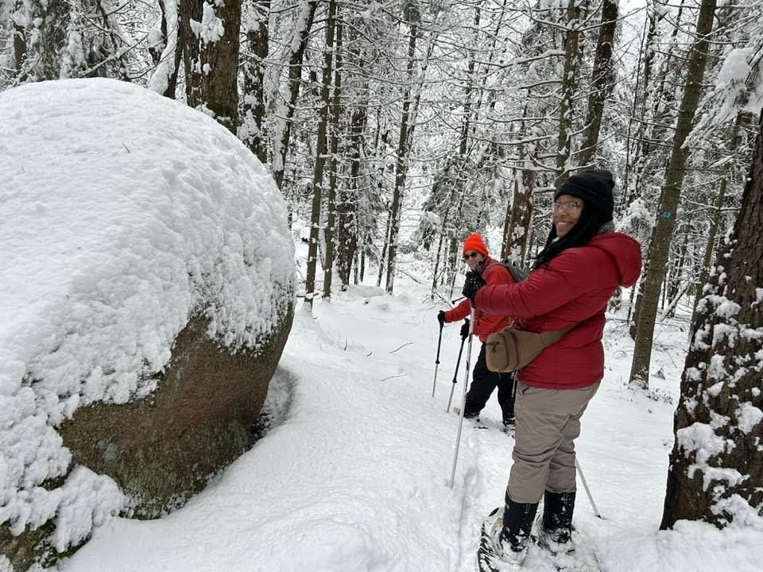

Slide 15
First Prize, People
Snow Bomb!
Jeff Miller

Slide 16
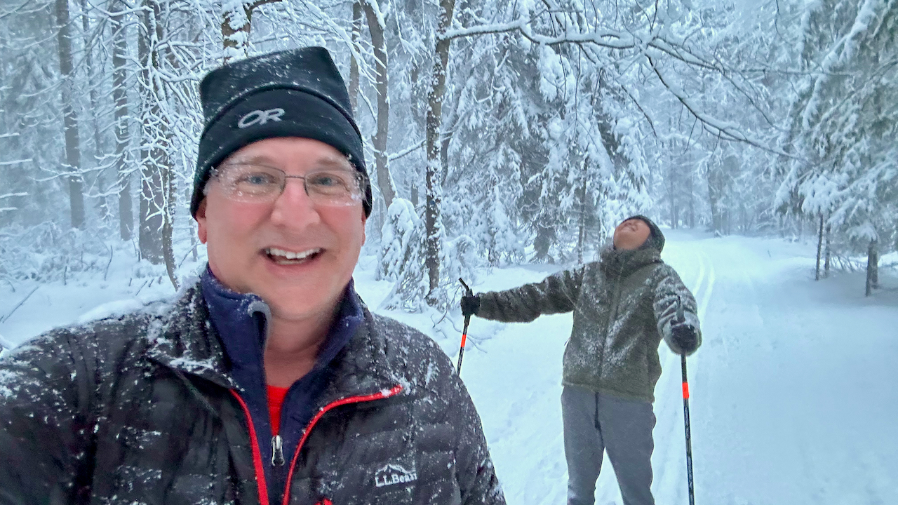

Slide 17
Nature Honorable Mention
Artic plants on the Burnt Cape Ecological Reserve, Newfoundland
Jeff Miller

Slide 18
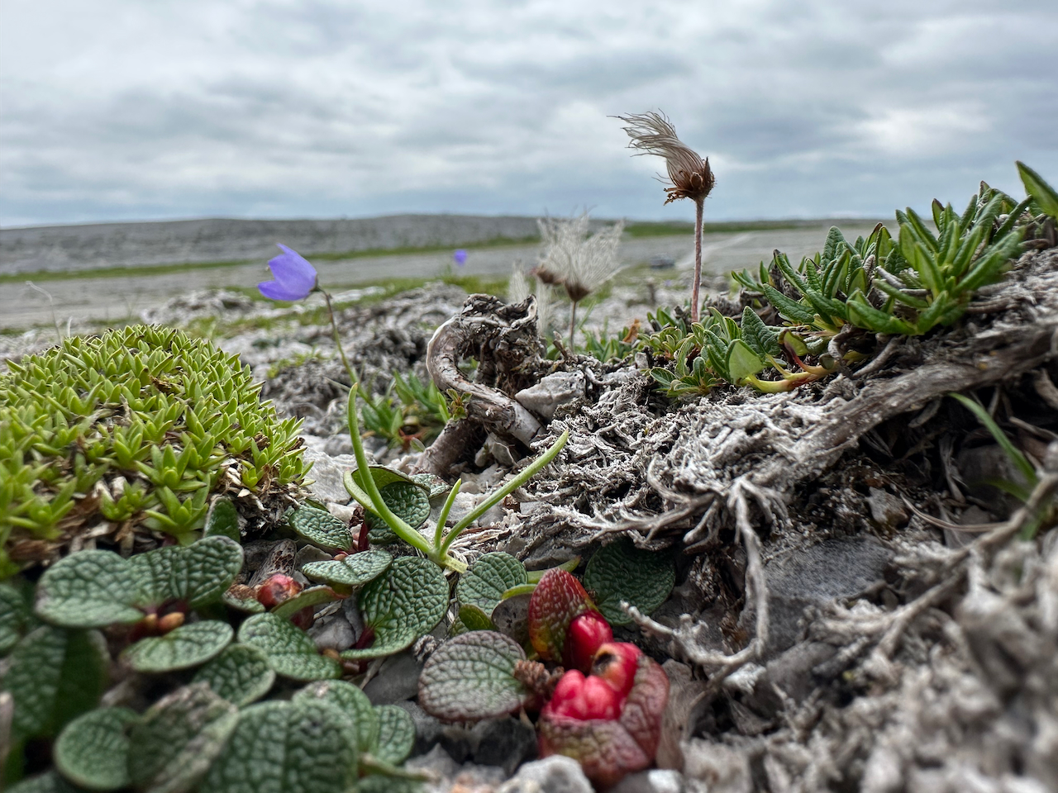

Slide 19
Nature Honorable Mention
Layers
Kim Bouchard

Slide 20
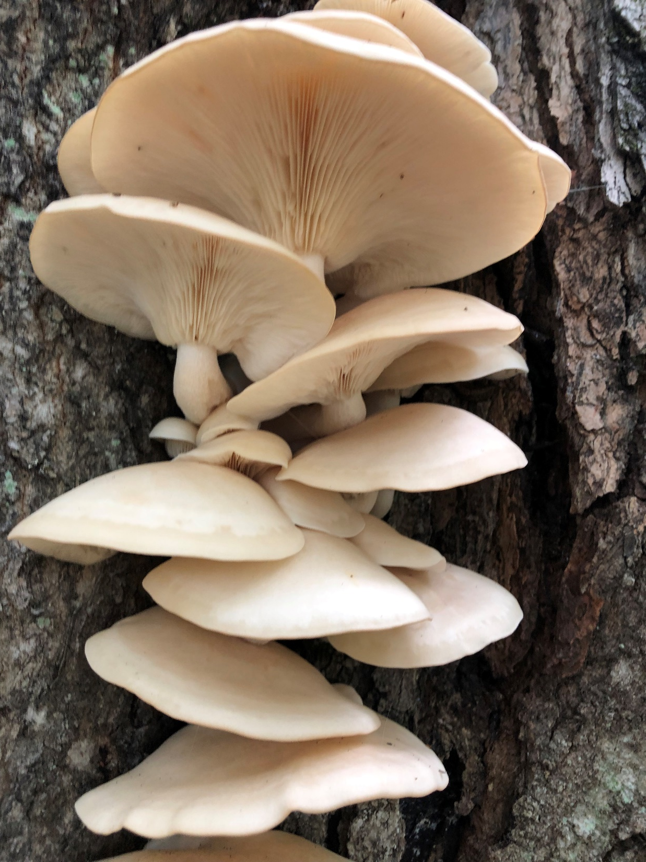

Slide 21
First Prize, Nature
Chipmunk Chowing UP at Nicholville Birdfeeder
Duncan Cutter

Slide 22
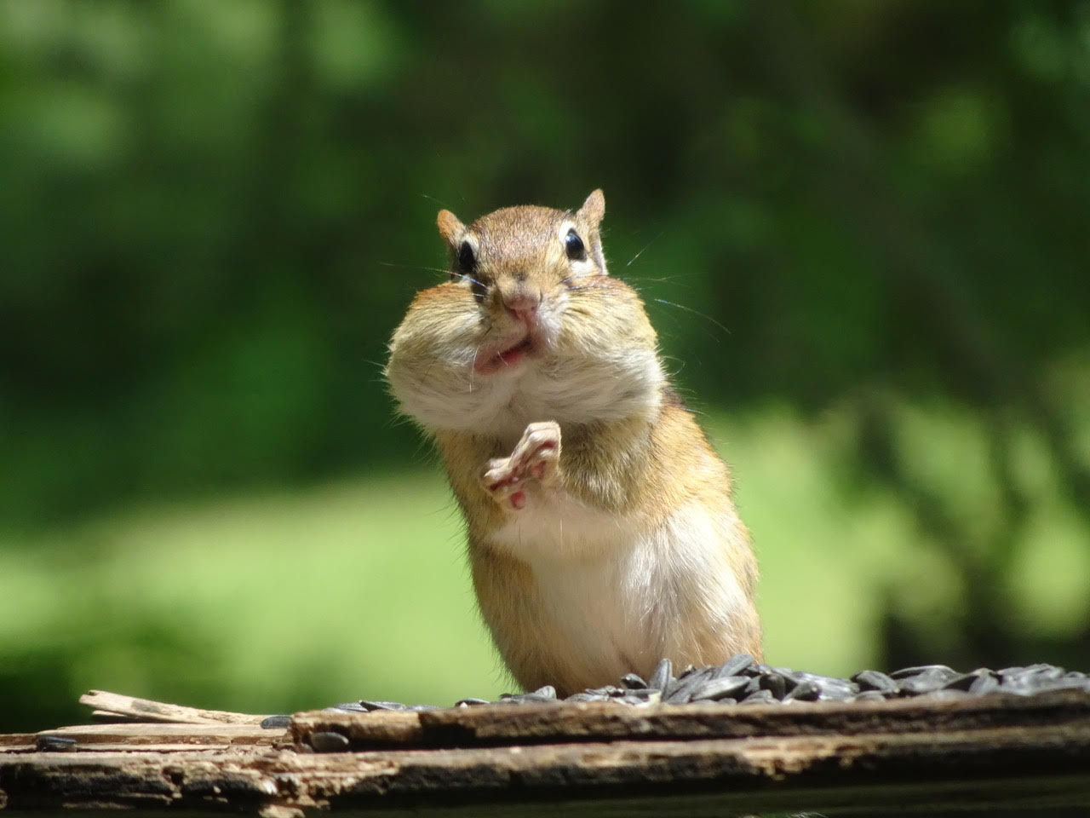

Slide 23
Action Honorable Mention
Stone Valley Group
Mark Simon

Slide 24
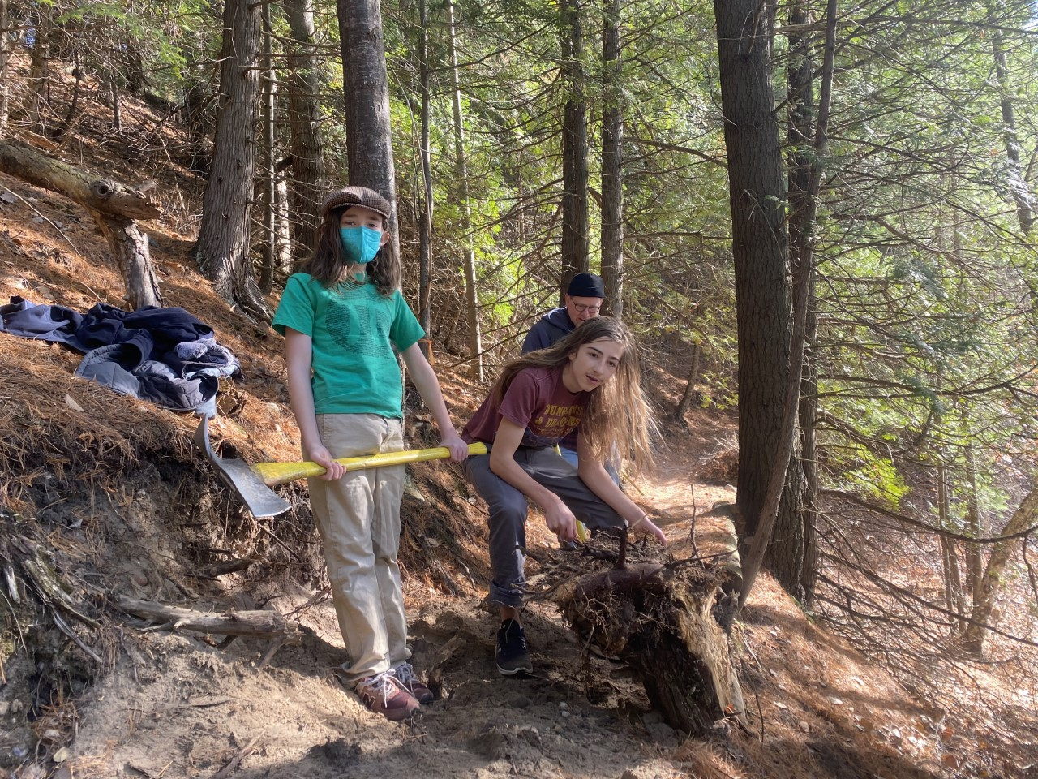

Slide 25
Action Honorable Mention
Catamount Snowshoe
Marianne Hebert

Slide 26
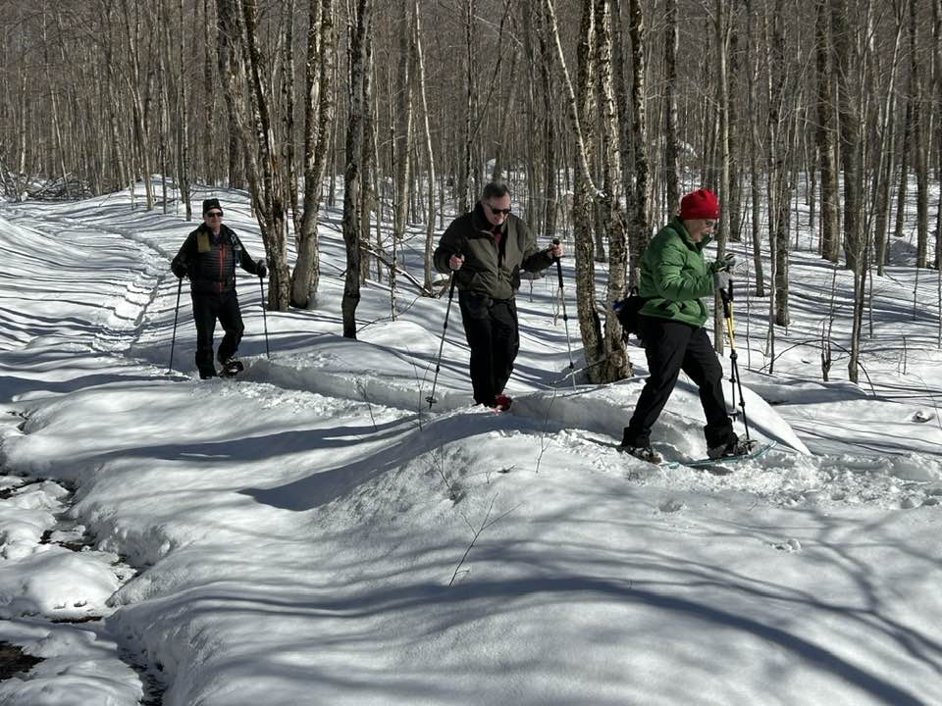

Slide 27
First Prize, Action
Learn to Snowshoe at Southville State Forest
Blair Madore

Slide 28
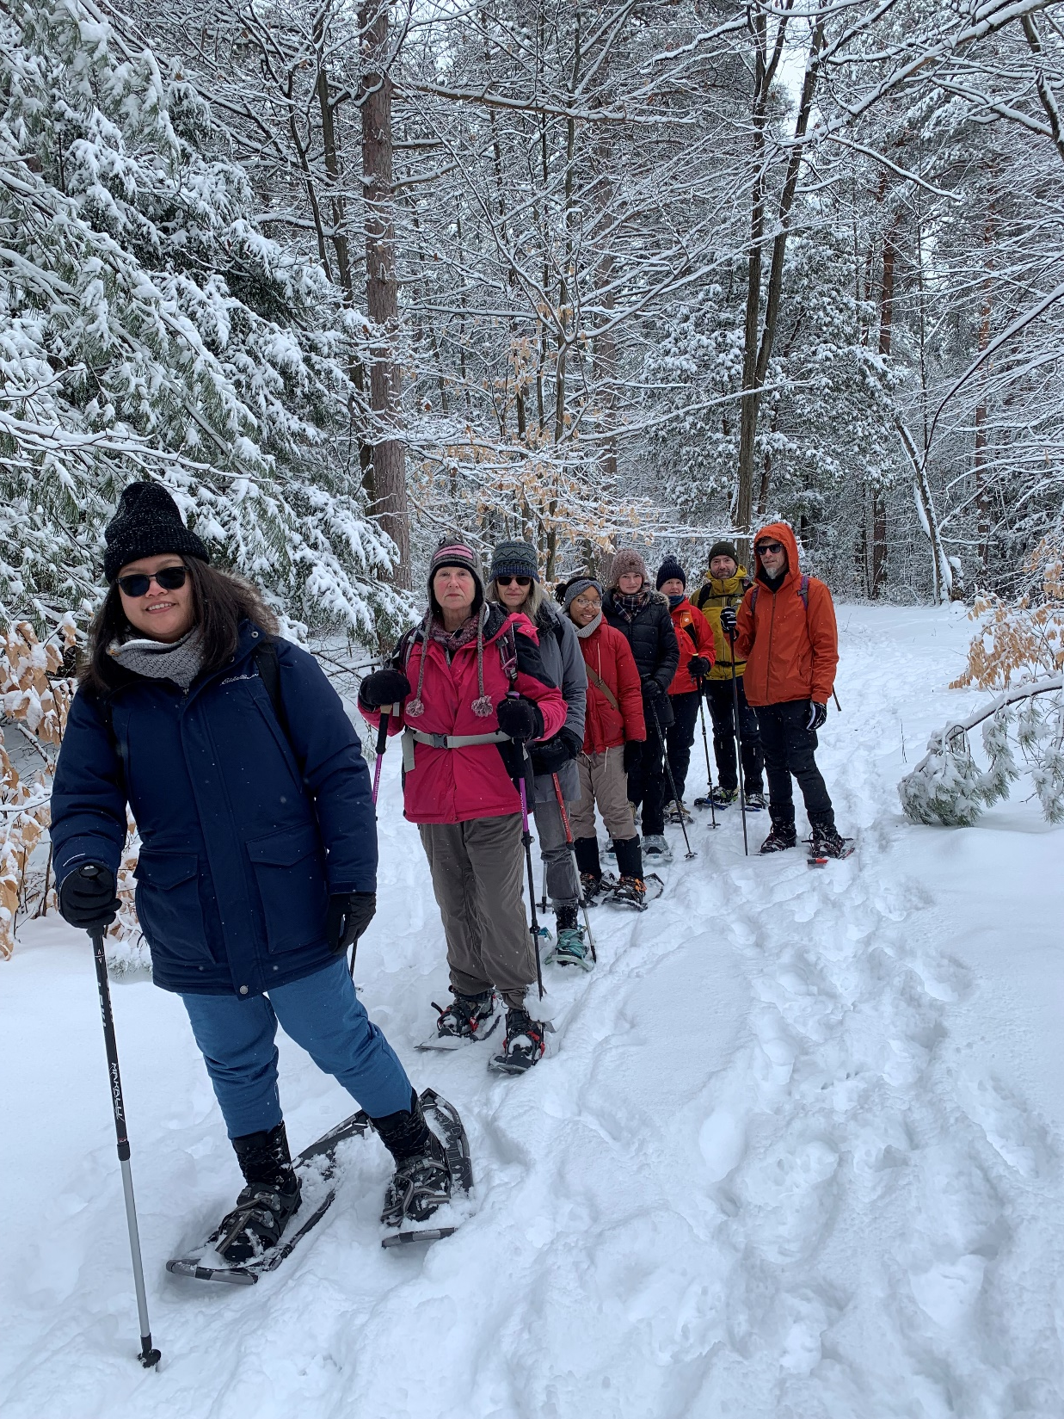

Slide 29
Artistic Honorable Mention
Hiding
Kim Bouchard

Slide 30
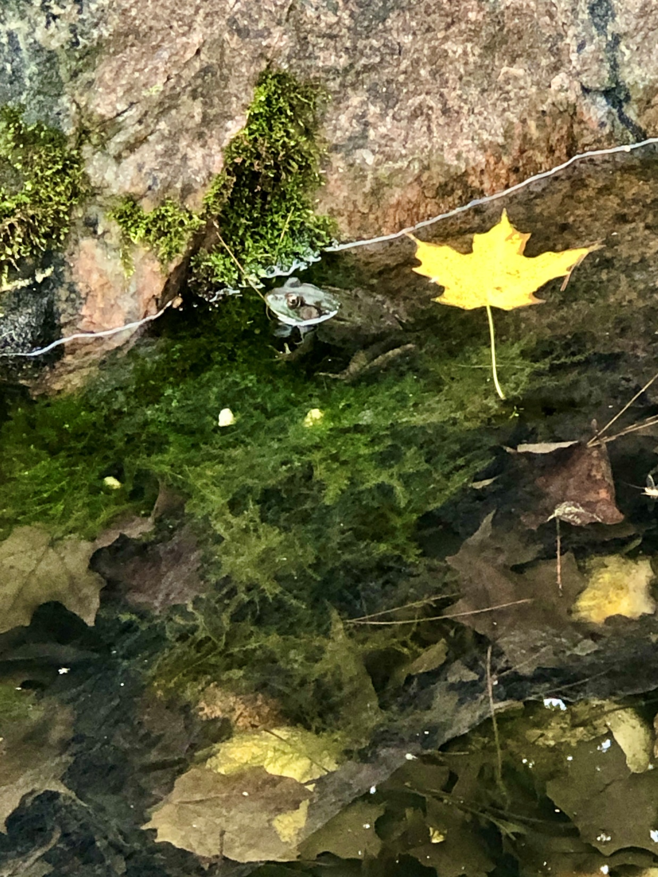

Slide 31
Artistic Honorable Mention
Stargazing while Night Skiing
Jeff Miller

Slide 32
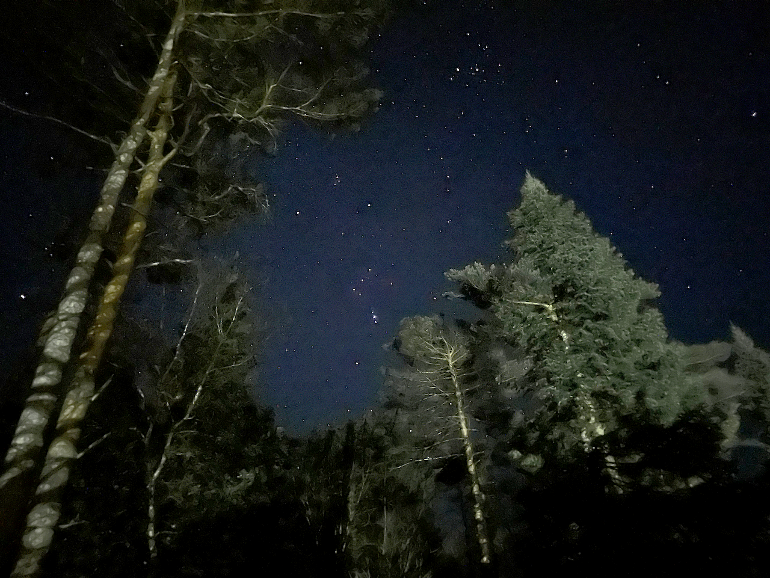

Slide 33
First Prize, Artistic
ADK December Night
Holly Chorba

Slide 34
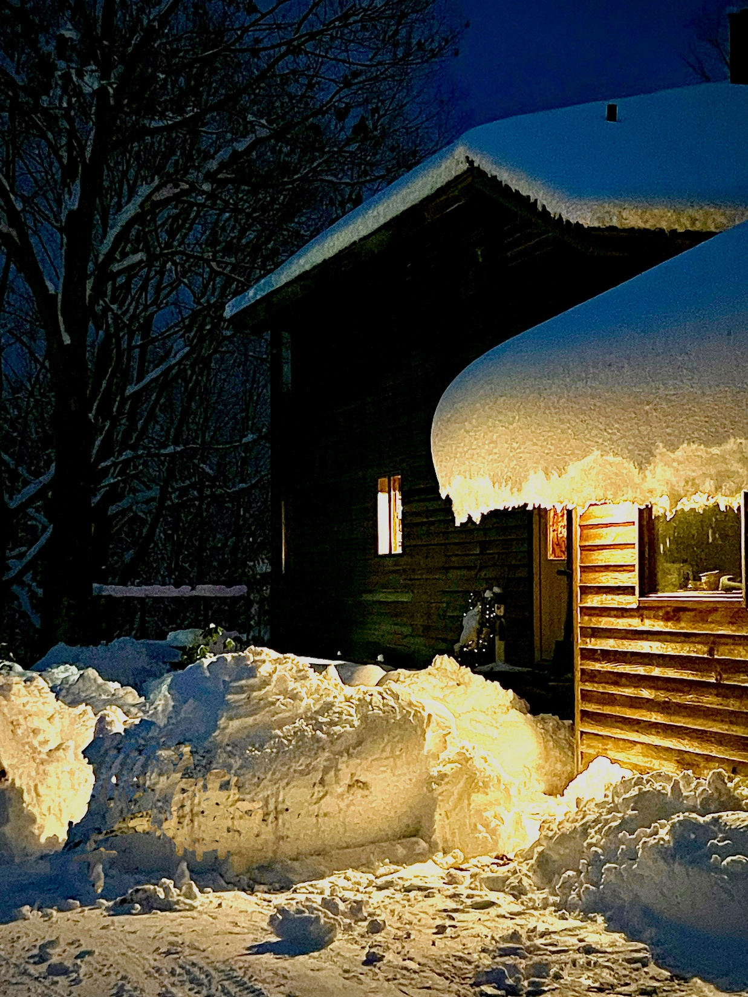

Slide 35
Grand Prize
Snowshoe Touring at Lampson Falls
Blair Madore

Slide 36
